Slide 1

Notes:
Hello everyone. My name is [presenter] and welcome to Medicare Orientation, an educational seminar brought to you by MedicareOnDemand.

Slide 2
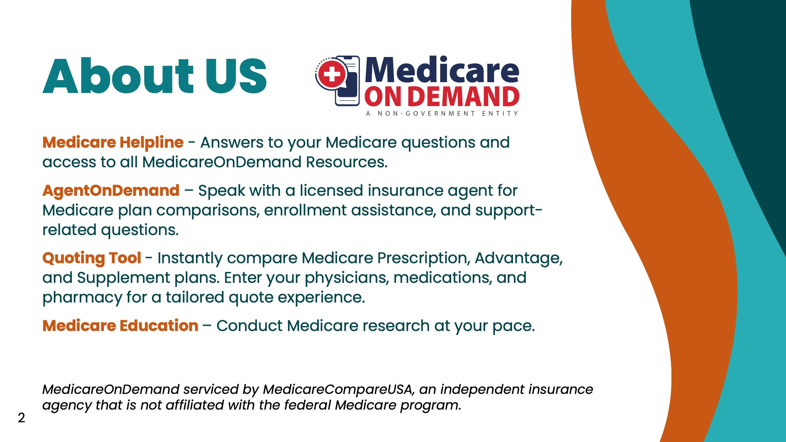
Notes:
MedicareOnDemand is a platform of Medicare resources provided by MedicareCompareUSA, an independent insurance agency that supports health systems and their patients with Medicare. MedicareOnDemand includes (read slide).

Slide 3

Notes:
Let’s start today’s program by discussing what is referred to as Original or Traditional Medicare.

Slide 4
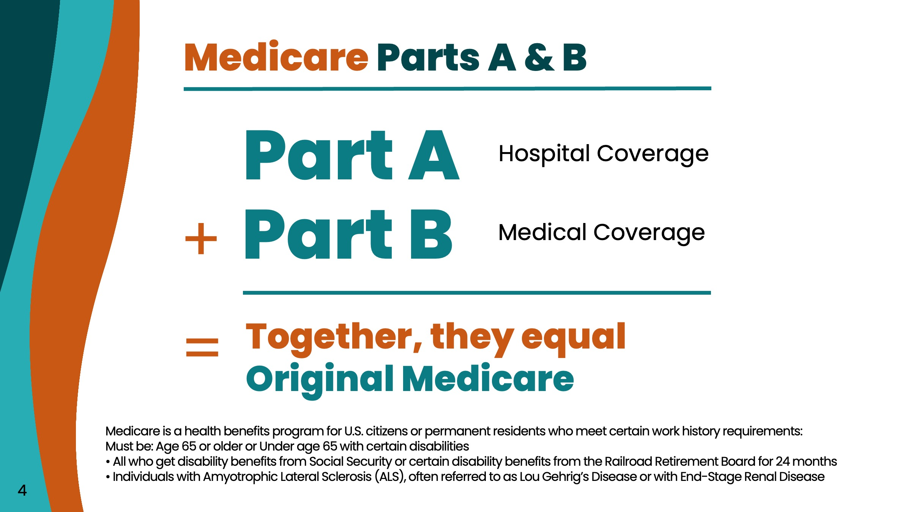
Notes:
Original Medicare is made up of two parts. Part A and Part B. Medicare Part A is your hospital coverage, and Medicare Part B is medical coverage.

Slide 5
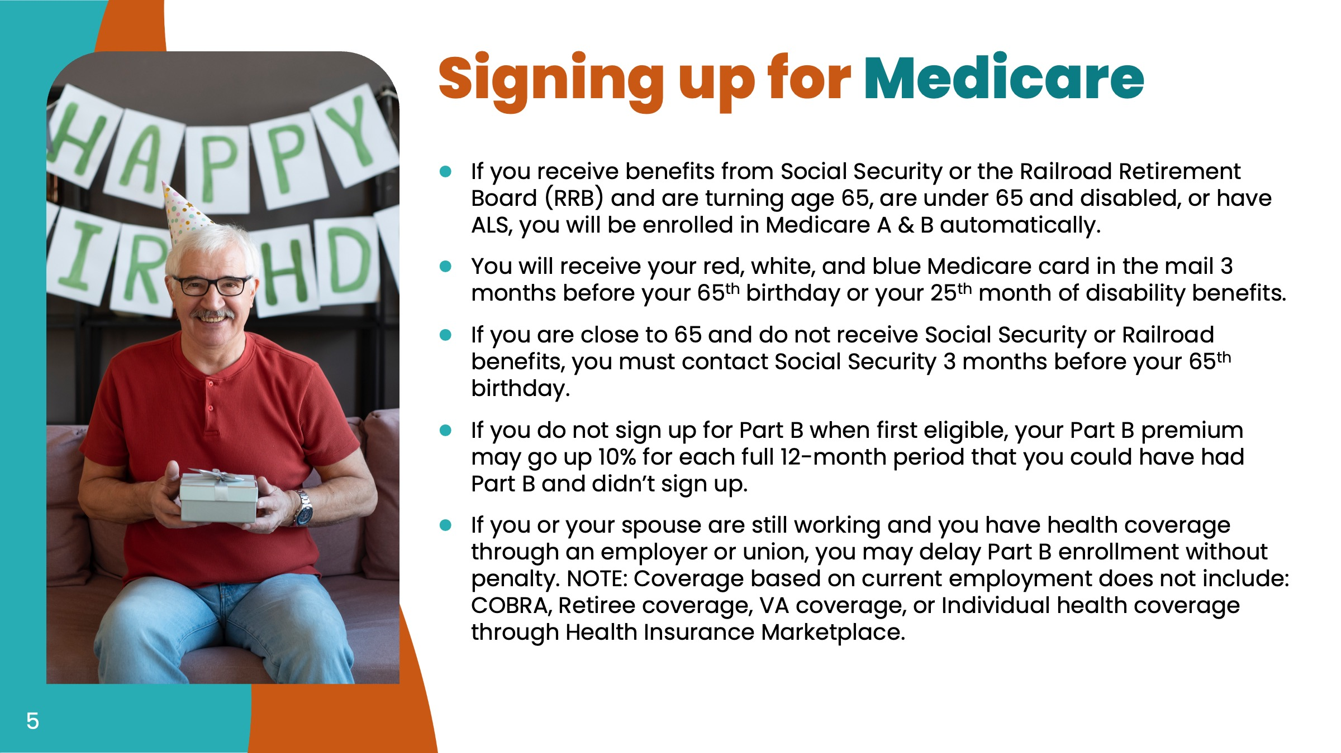
Notes:
Read bullets in entirety

Slide 6
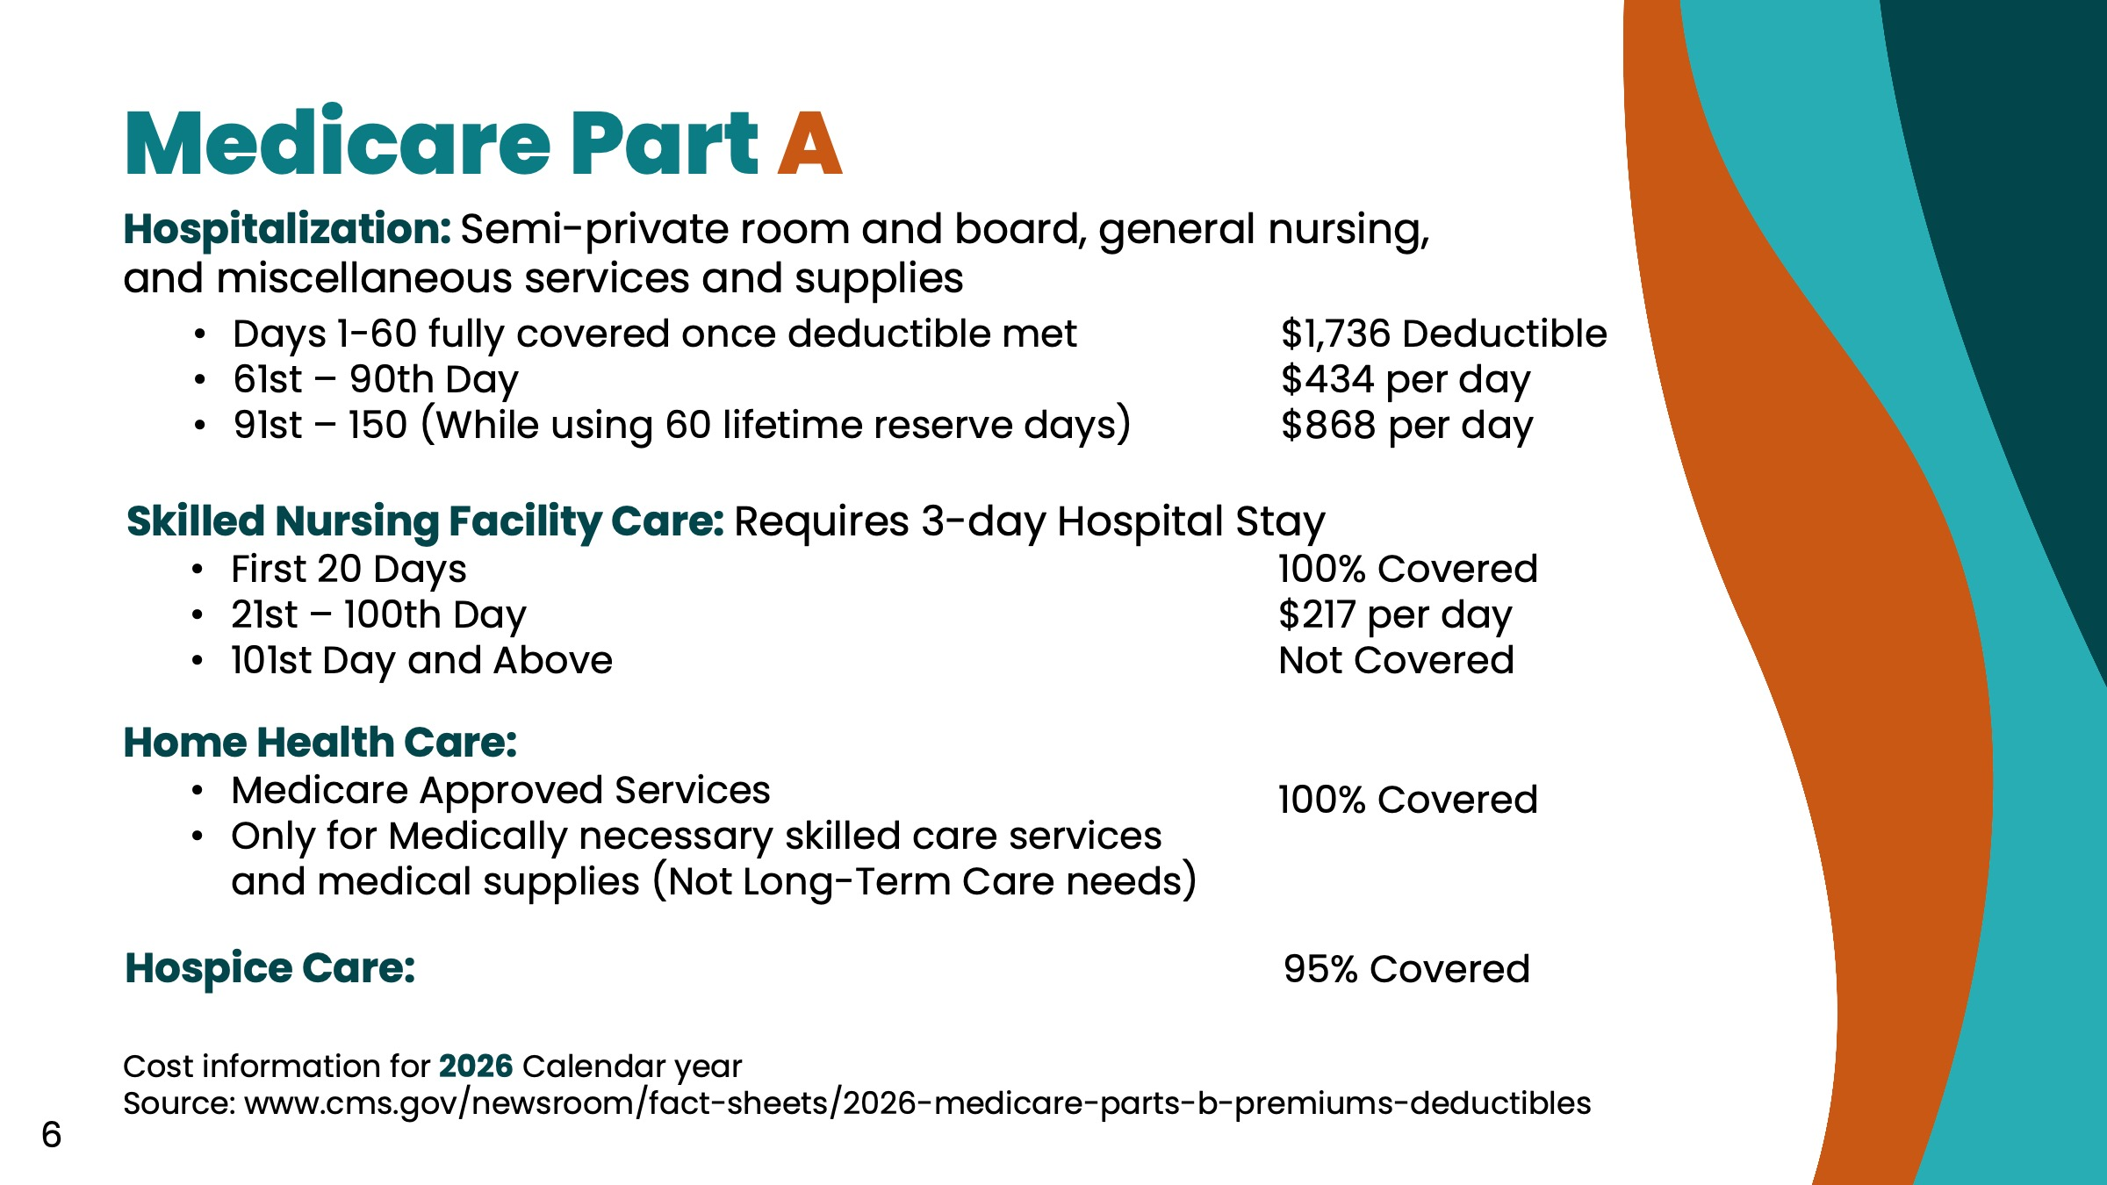
Notes:
Medicare Part A covers hospitalization, skilled nursing, home health, and hospice care. For hospitalization, Medicare Part A covers a semi-private room, meals, general nursing, and your supplies while in the hospital. There is a Part A deductible and that covers the first 60 days while in the hospital. Should you be in the hospital for longer than 60 days, you then have a daily copayment for days 61-90 and a higher copayment for days 91-150. These last days mentioned are called your Lifetime Reserve Days, and they can only be used once in your life.
Next, let’s talk about Skilled Nursing Care. This level of care is provided in a Skilled Nursing Facility, which can be part of a hospital or nursing home. This is not considered nursing home coverage, and the big difference is that your doctor assigns you to a skilled nursing facility when you are recovering from an illness or injury. This also requires you to be admitted to the hospital for 3 or more days. When in a skilled nursing facility, Original Medicare covers all costs for the first 20 days. If you remain in a skilled nursing facility for longer, Medicare requires you to pay a daily copayment for days 21-100. Beyond 100 days, Original Medicare does not cover skilled nursing care. However, your coverage for skilled nursing care does reset after you have been discharged for 60 or more days.
The last component of Medicare Part A has to do with home health care. This is care you receive while at home, when recovering from illness or injury. This is not long-term care coverage, but rather medically-necessary care that is provided by a licensed home healthcare provider. Again, the important points here are that your doctor must indicate that you are recovering from an illness or injury, and home health does not include things like meal preparation or activities of daily living associated with long-term care.

Slide 7
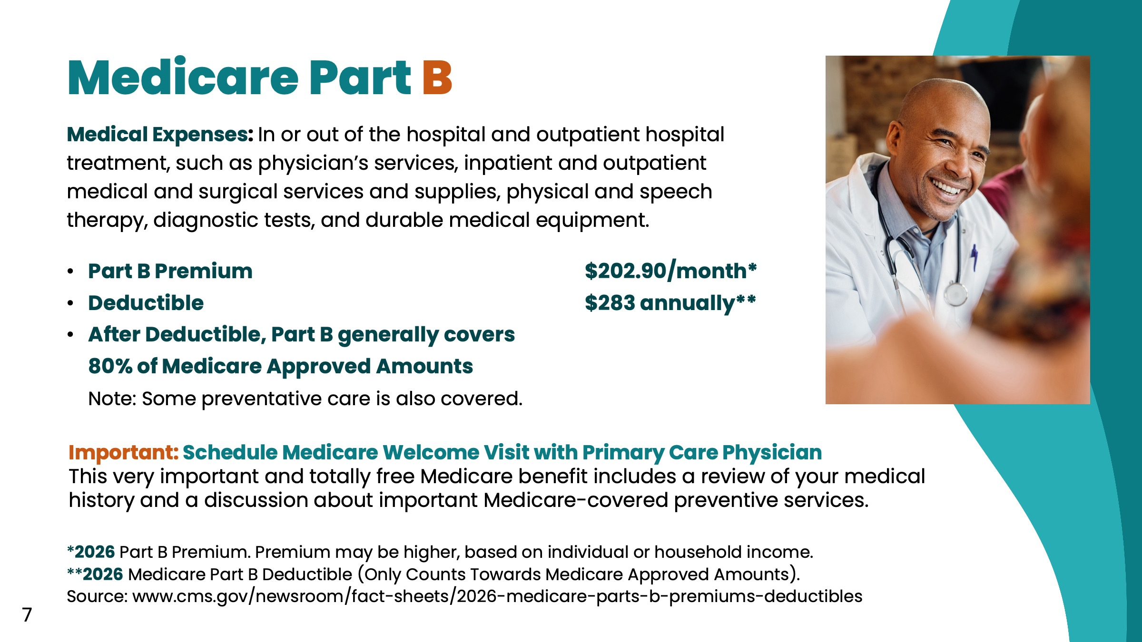
Notes:
Now let’s talk about Medicare Part B. As you can see, Medicare Part B refers to medical expenses (read text for medical expenses).
Medicare Part B includes a monthly premium, which is either withdrawn from your Social Security check or paid directly. Your premium may be higher, based on individual or household income.
Medicare Part B has an annual deductible that must be met before Medicare beings to pay. This is a calendar year deductible, unlike the Medicare Part A deductible which is a deductible per hospital admission.

Slide 8
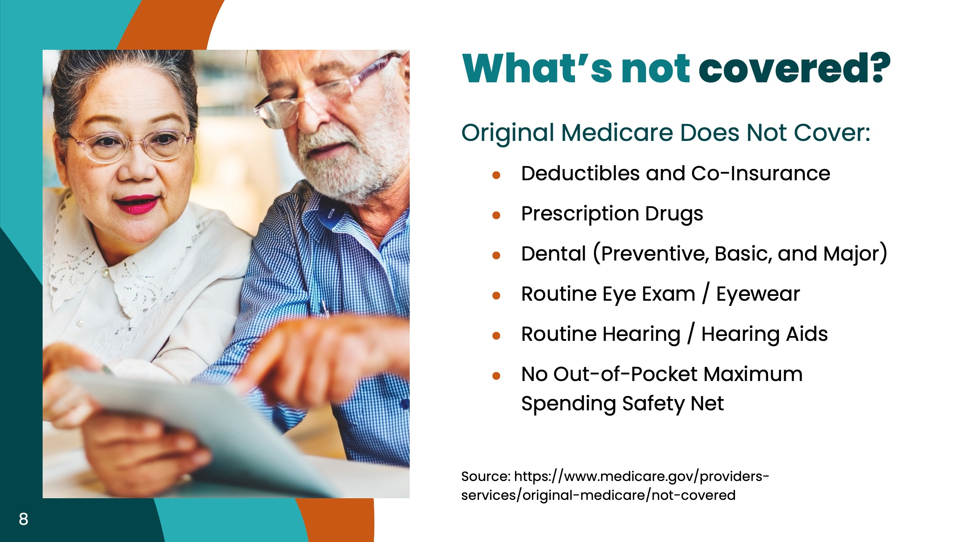
Notes:
Medicare does not cover all expenses. Here are the major items not covered by Medicare (read bullets).
Also keep in mind that Original Medicare was structured to only cover about 80% of your healthcare expenses. Which leads to our next slide…

Slide 9
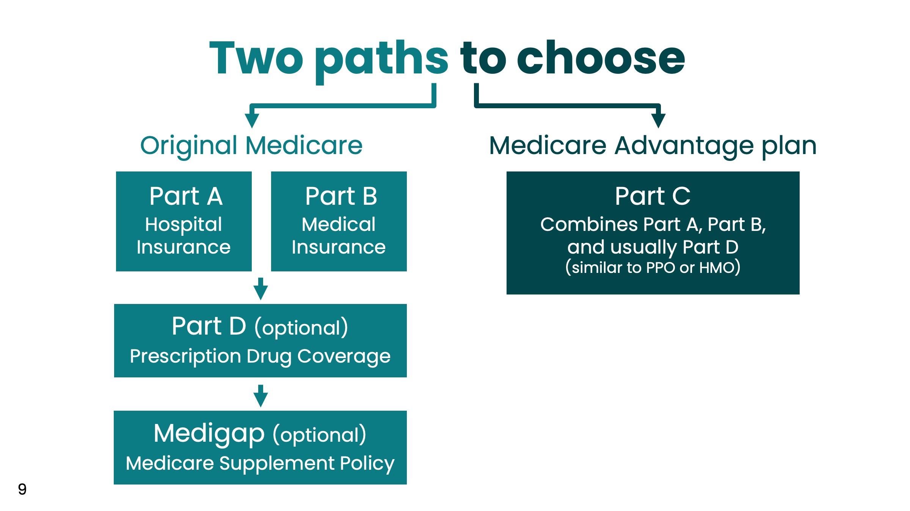
Notes:
This is a very important slide, if you will be personally responsible for choosing your Medicare insurance coverage; meaning you are not being offered Medicare coverage in conjunction with your employer or the like.
There are two basic paths you can choose when it comes to purchasing Medicare insurance. You will see Original Medicare on the left and Medicare Advantage (also referred to as Medicare Part C) shown on the right.
Take the audience down each path, reading from the slide.
Now, let’s go into more detail about these two types of Medicare insurance: Medicare Supplement and Medicare Advantage.

Slide 10
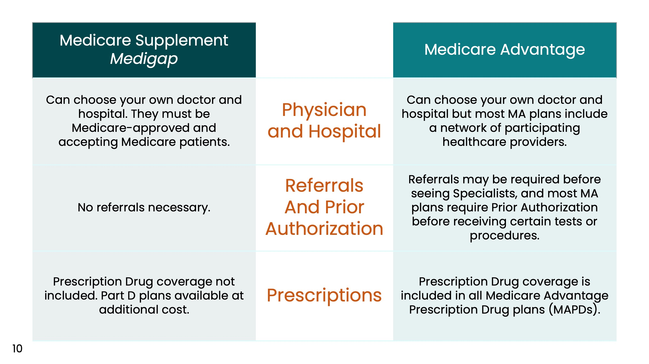
Notes:
On the left are Medicare Supplement plans, also sometimes referred to as Medigap plans. On the right, are Medicare Advantage plans, also referred to as Medicare Part C.
Let’s start by talking about accessing your physicians and hospital. With a Medicare Supplement, you are able to see any Medicare approved physician and hospital. With Medicare Advantage, most plans today feature a network of healthcare providers, so it is important to make sure your physicians and hospital are in the network with any Medicare Advantage plan you are considering; otherwise, you may need to change healthcare providers, or your cost-sharing may be greater. We will talk more about the network requirements of Medicare Advantage in a moment.
Next are Referrals and Prior Authorization. With a Medicare Supplement, you can see any Medicare approved provider without the requirement of a referral from your Primary Care Physician. With Medicare Advantage plans, namely HMOs, a referral is usually required by your Primary Care Physician before you can see a Specialist. Prior Authorization is often required by Medicare Advantage plans before receiving tests or procedures.
The last item here are Prescription Drug plans. With a Medicare Supplement, prescription coverage is not included. This means a Medicare Prescription plan needs to be purchased separately if you want coverage for your medications. With Medicare Advantage HMO and PPOs, you will usually have a Medicare Prescription plan included. We will talk more about Prescription plans in a few minutes.

Slide 11
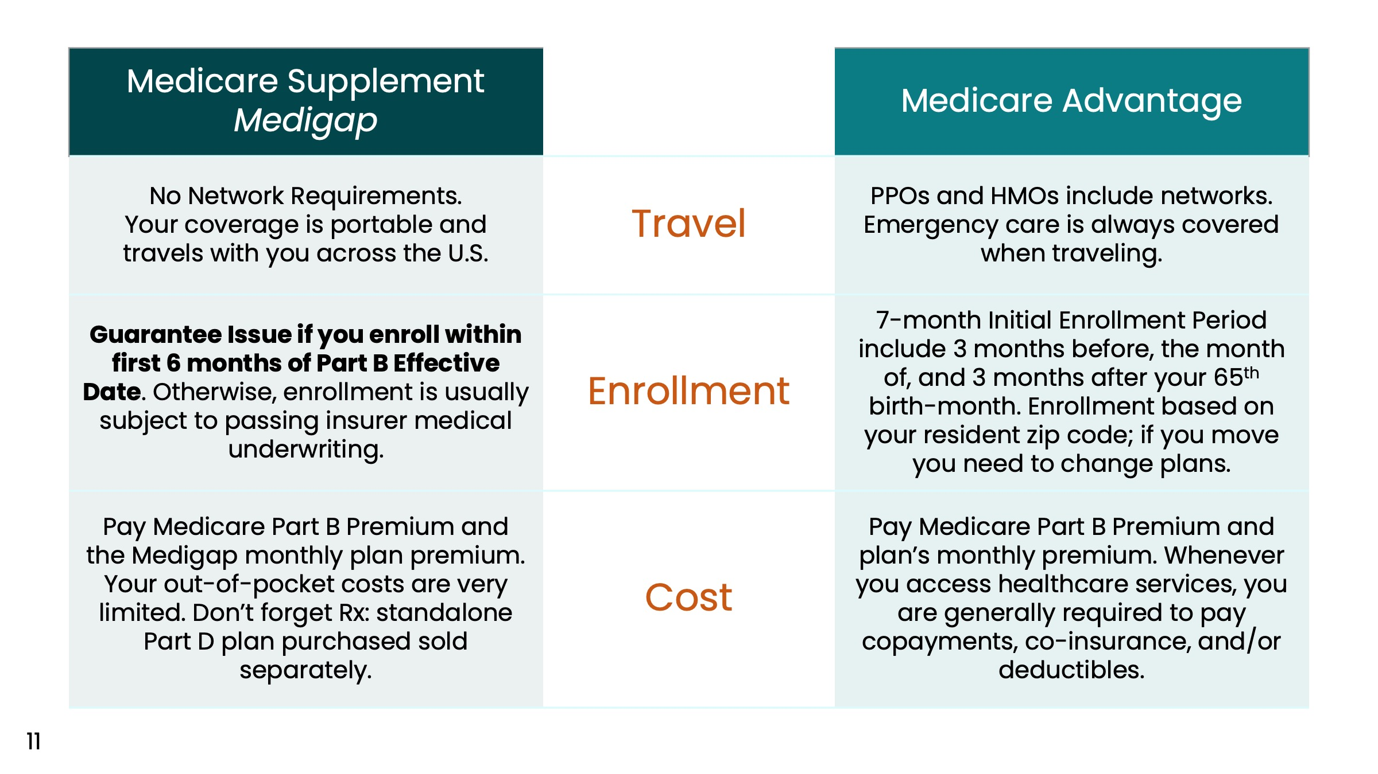
Notes:
Then we have details about Medicare coverage and Travel. Because the vast majority of Medicare Supplement plans have no network requirements, this means you can see any healthcare provider that is certified by Medicare when you are traveling in the United States, and some Medicare Supplement plans offer a foreign travel benefit. With Medicare Advantage plans, you can see any Medicare certified provider when you are traveling and there is an emergency. However, when there is not emergency and you want to see a healthcare provider, you need to be aware of the network requirement of your Medicare Advantage plan.
Regarding plan enrollment, Medigap plans provide you with a six-month Medigap Open Enrollment period in which you can enroll in any plan without the requirement of medical underwriting. After your Medigap Open Enrollment Period ends six months after your Medicare Part B benefits began, you will likely have to qualify for coverage by answering the insurance company’s health questions and you may be subject to a waiting period for pre-existing conditions.
With Medicare Advantage plans, you are able to enroll during the Medicare Annual Enrollment Period each year from October 15 until December 7. You also have an initial coverage election period (ICEP) that begins 3 months before you become eligible for Medicare Part B, and it lasts until 3 months after your Part B has taken effect. Also, you may be eligible for Special Election Periods in certain scenarios including but not limited to: a change of residence, loss of employer coverage, or if your current plan is no longer available. With Medicare Advantage plans, there are no health questions. You just need to have Medicare Part A and Part B and live in the plan’s service area.
Lastly, let’s discuss cost. Regardless of whether you choose a Medicare Supplement or Medicare Advantage plan, you must have Medicare Parts A and B. For Medigap, you will then definitely have a monthly plan premium, but very limited cost-sharing. You do, however, need to purchase a standalone Medicare Prescription Drug plan if you want coverage for your medications. For Medicare Advantage plans, the monthly plan premium is usually low or even a zero monthly plan premium. However, when you access healthcare services, you are generally required to pay copayments, co-insurance, and/or plan deductibles.

Slide 12

Notes:
Now let’s take a closer look at Medicare Advantage.

Slide 13
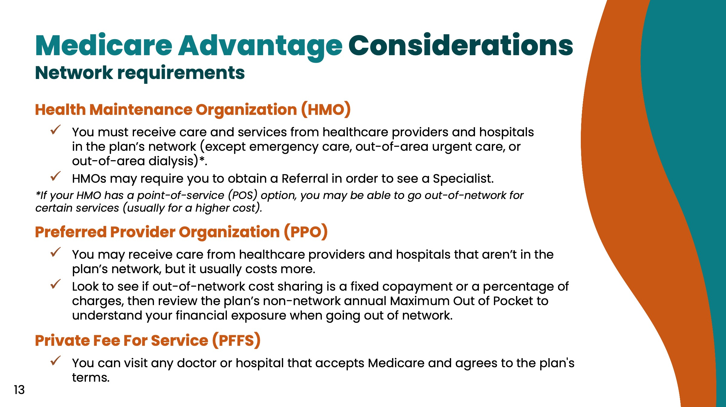
Notes:
The two most popular types of Medicare Advantage plans are HMOs and PPOs.
An HMO, or health maintenance organization, includes a network of healthcare providers. In most cases, you will need to use network providers for all of your healthcare services. The exceptions would be in an emergency or if you have a special HMO known as a Point of Service plan. Otherwise, if you receive care from a non-network provider, your plan will deny coverage.
A PPO, or preferred provider organization, also has a network of contracted healthcare providers. The difference is that you are able to receive care from non-network providers but usually this will require you to pay higher member cost-sharing. Here’s a tip, look carefully at the PPO cost-sharing requirements to see if you are required to pay a fixed amount, called a copayment, or a percentage of charges, called coinsurance. This can be important because paying a percentage of charges can get very expensive.

Slide 14
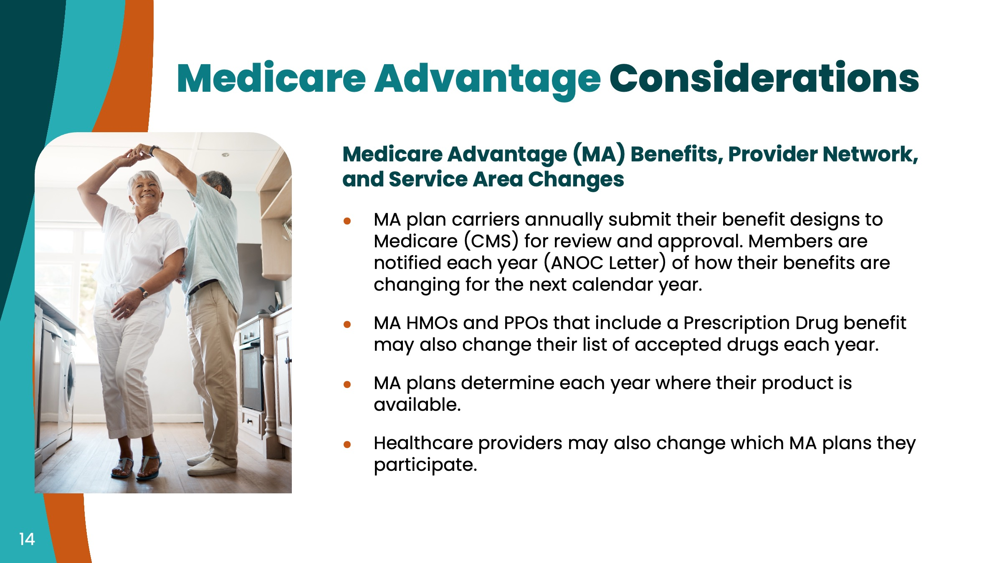
Notes:
If you are considering a Medicare Advantage plan, be advised that these plans have annual contracts with Medicare, and each year the plan submits their benefit design to the Centers for Medicare and Medicaid Services (CMS). Each year, the Medicare Advantage plan will notify members by an ANOC letter, which stands for Annual Notice of Change, of all changes taking place for the next calendar year. These changes can include benefits, plan premium, provider network changes, and even whether the Medicare Advantage plan will be available in your county for the next calendar year. It is most important to carefully review your ANOC letter each year at the beginning of the Medicare Annual Enrollment Period.

Slide 15
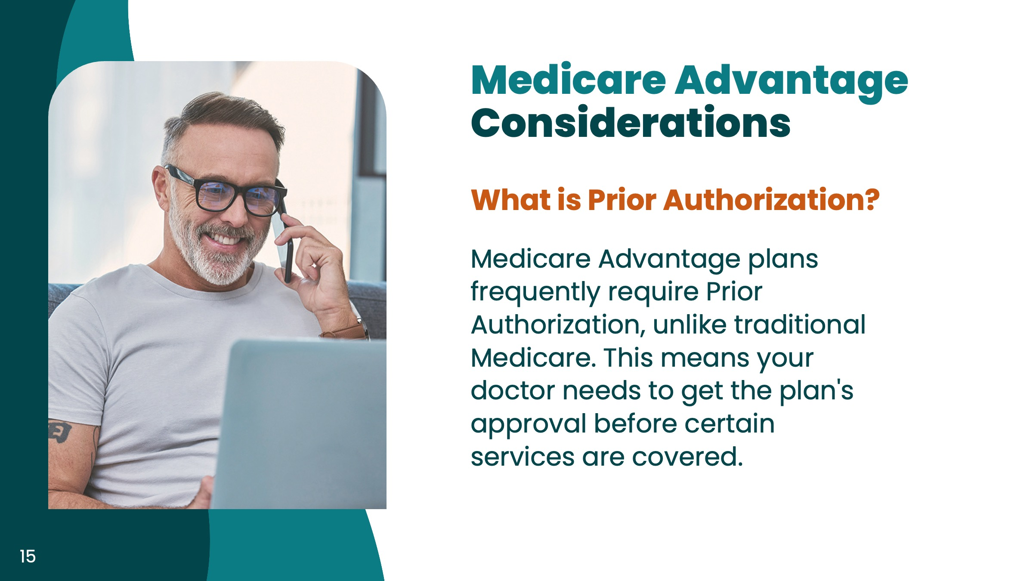
Notes:
Another important term you should be aware of with Medicare Advantage plans is Prior Authorization. Most Medicare Advantage plans require you to obtain prior authorization from the plan before obtaining healthcare services. If you fail to receive Prior Authorization when it is required, the plan may deny coverage.

Slide 16

Notes:
Now let’s talk about Medicare Supplement plans, also knows as Medigap.

Slide 17
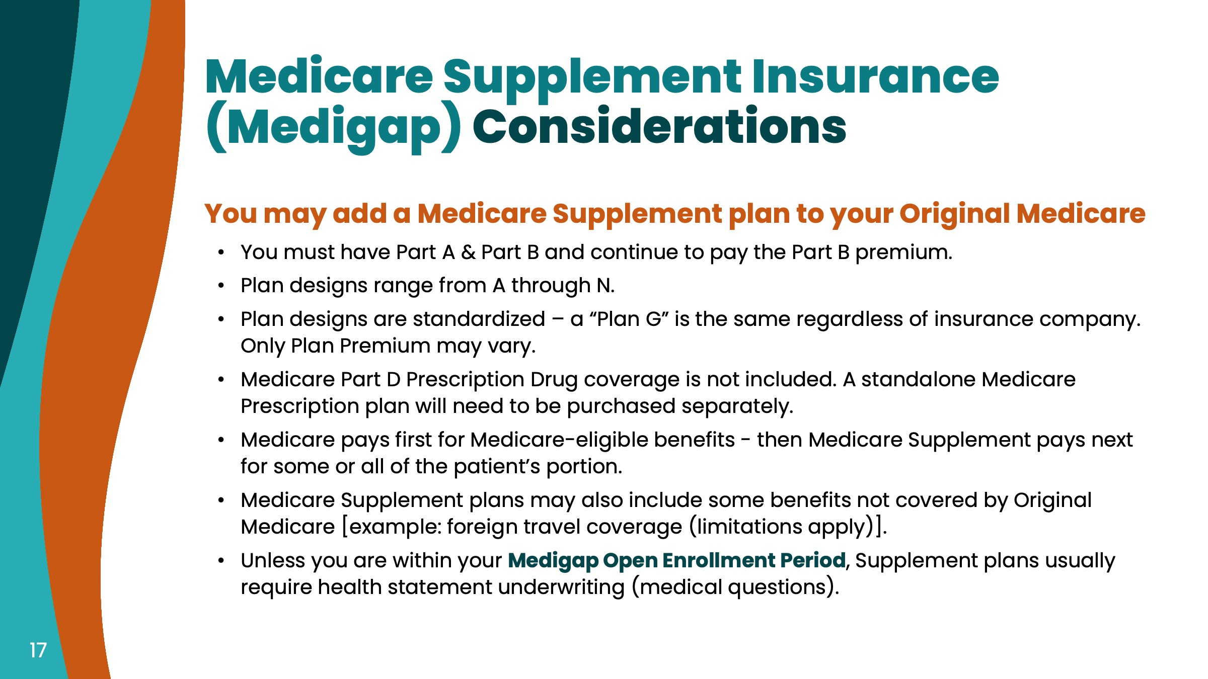
Notes:
Read all bullets

Slide 18
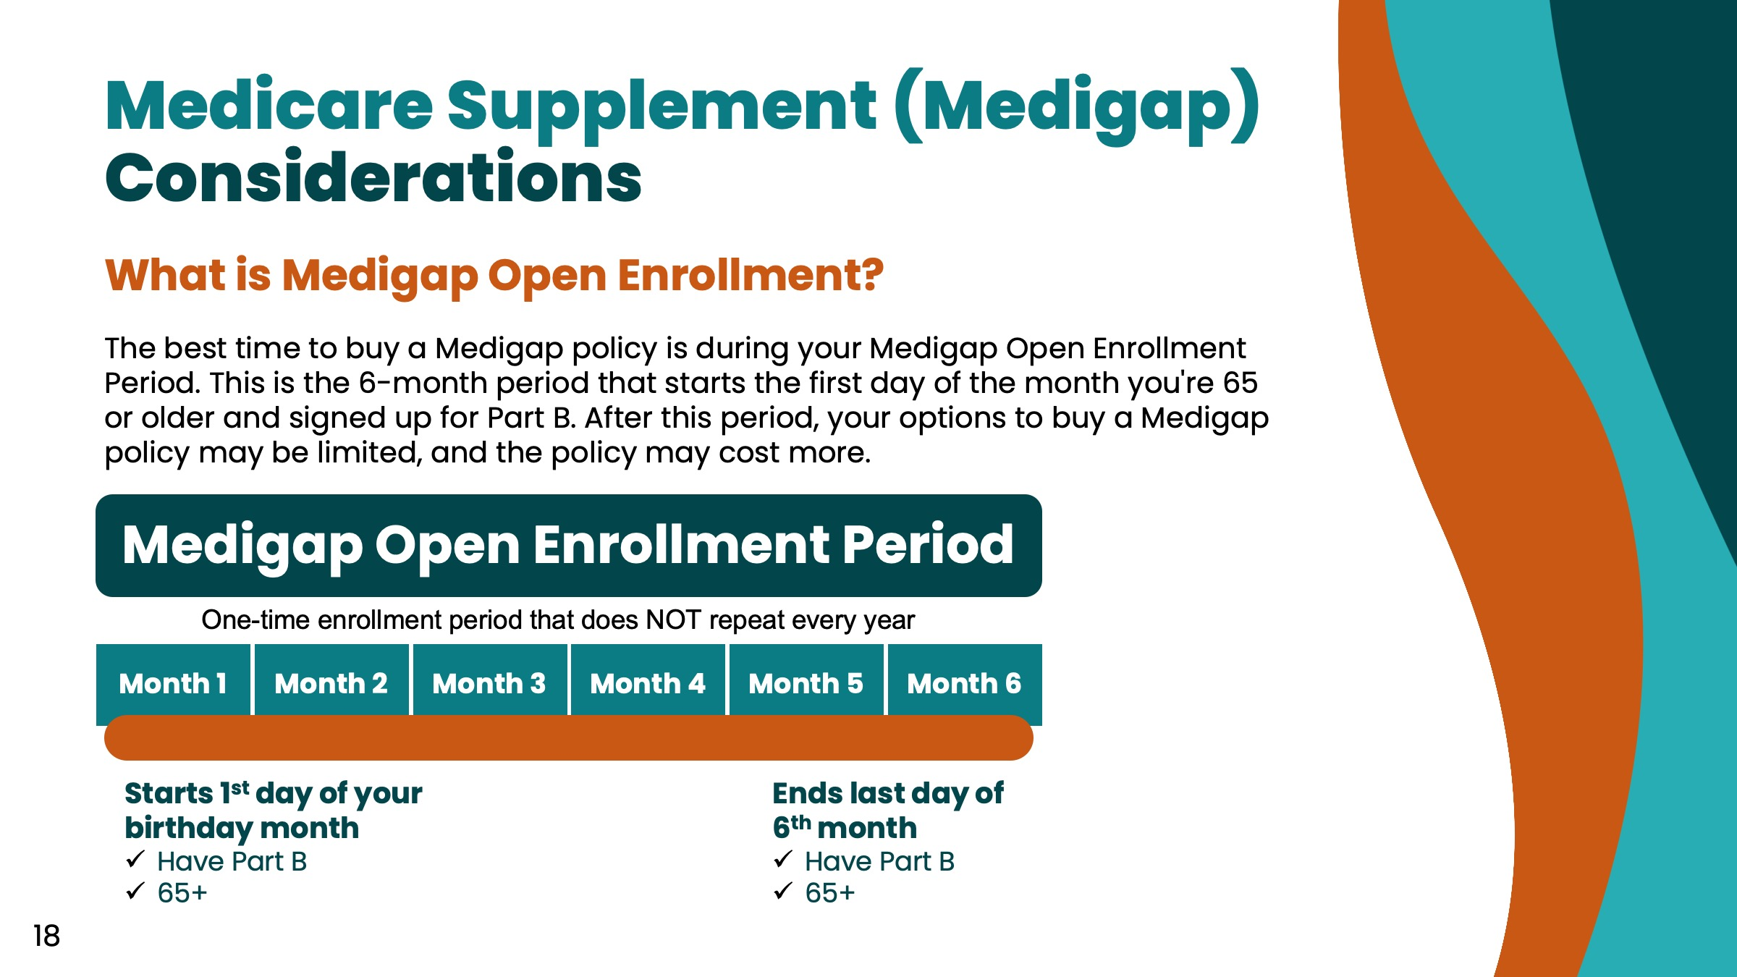
Notes:
We touched on this next subject a few slides back, but let’s talk further about your Medigap Open Enrollment Period and why it can be so important for some.
When your Medicare Part B benefits begin, you have a six-month period in which you can join any Medicare Supplement on a guarantee-issue basis. That means the insurance company cannot deny you coverage regardless of any health conditions you may have.
(Proceed to next slide)

Slide 19

Notes:
If you miss your Medigap Open Enrollment Period, you will likely have to pass medical underwriting before a Medicare Supplement plan will issue you coverage. Most often, medical underwriting requires you to answer a series of health questions and if you answer “yes” to any of them, you will not qualify for coverage.

Slide 20

Notes:
Now let’s talk about Medicare Prescription Drug plans.

Slide 21
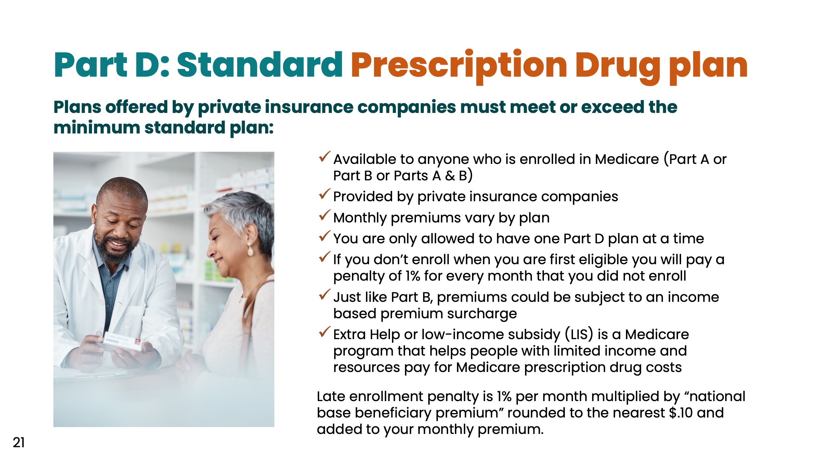
Notes:
Read bullets

Slide 22
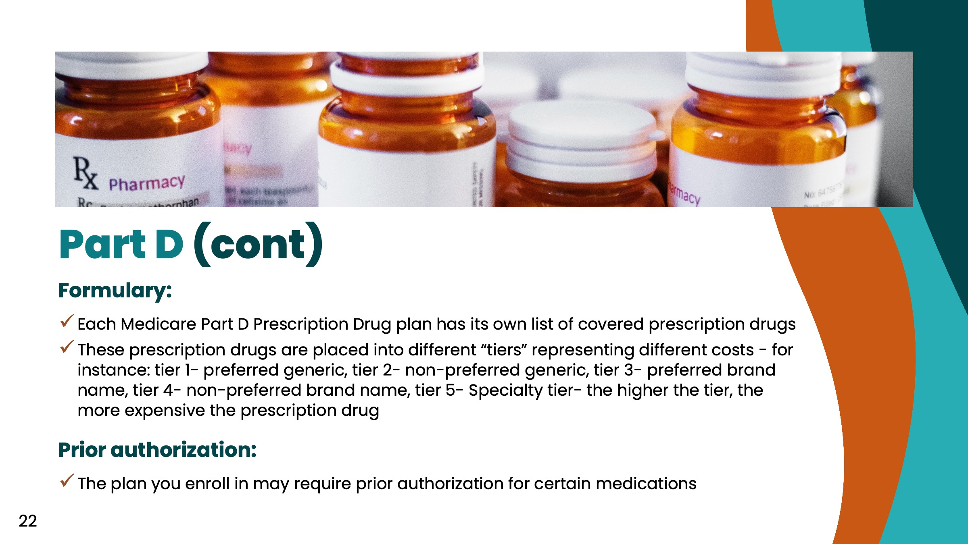
Notes:
Read bullets

Slide 23
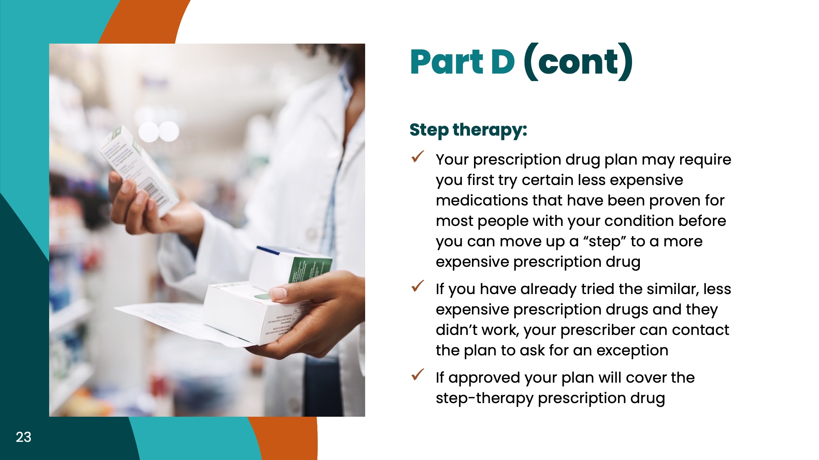
Notes:
Read bullets

Slide 24
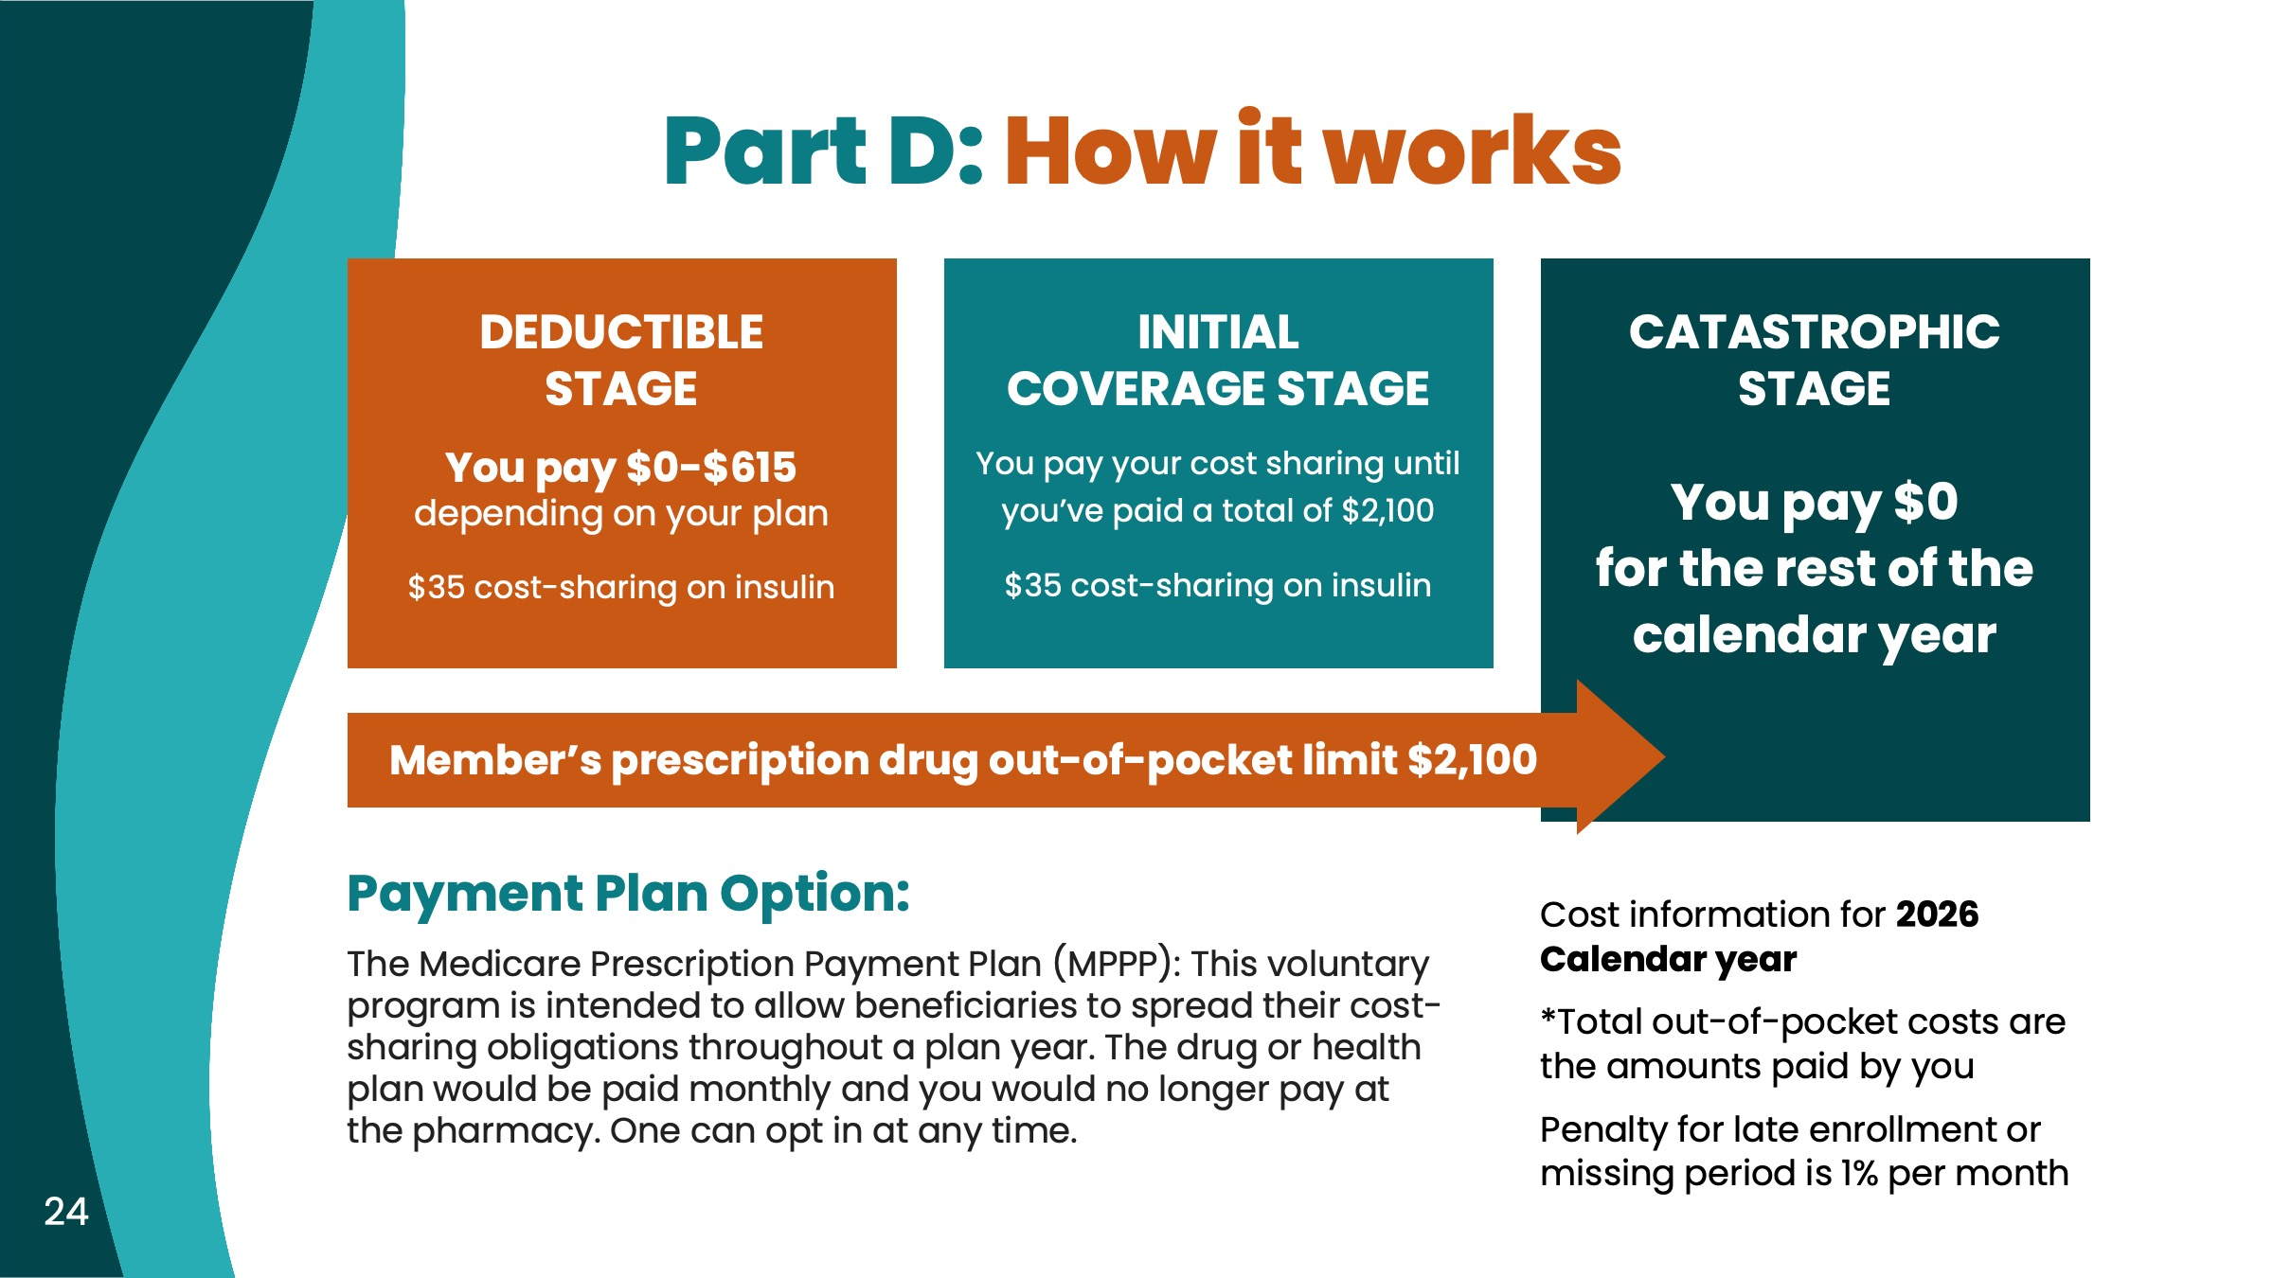
Notes:
This slide shows you the different stages of a Medicare Prescription Drug plan.
Read bullets

Slide 25

Notes:
Now let’s review a few additional bits of information.

Slide 26
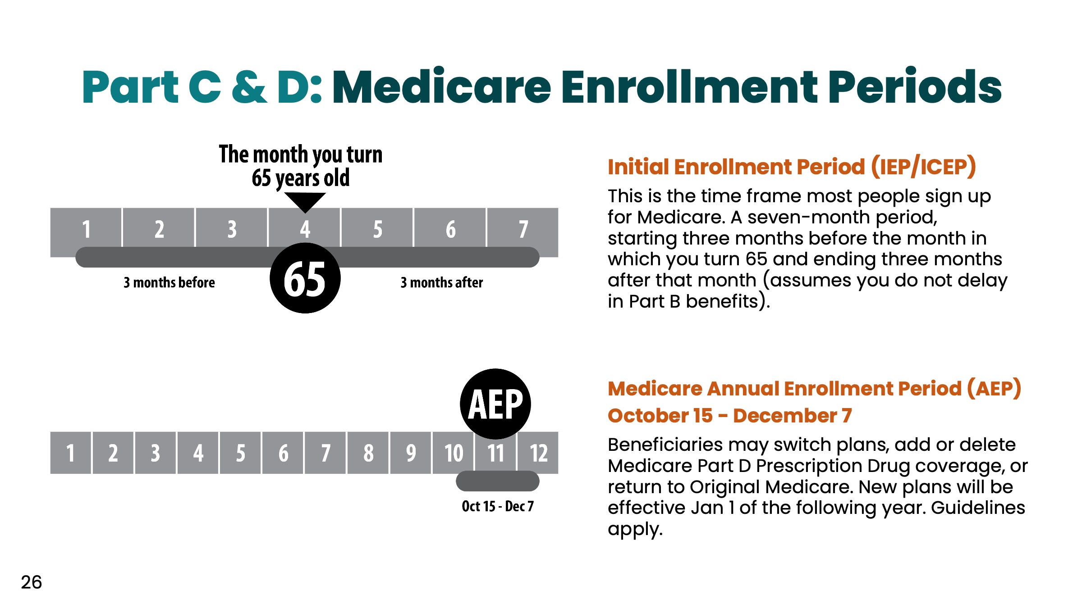
Notes:
If you are considering a Medicare Advantage or Medicare Prescription plan, here is how the enrollment periods work.
Read sections

Slide 27
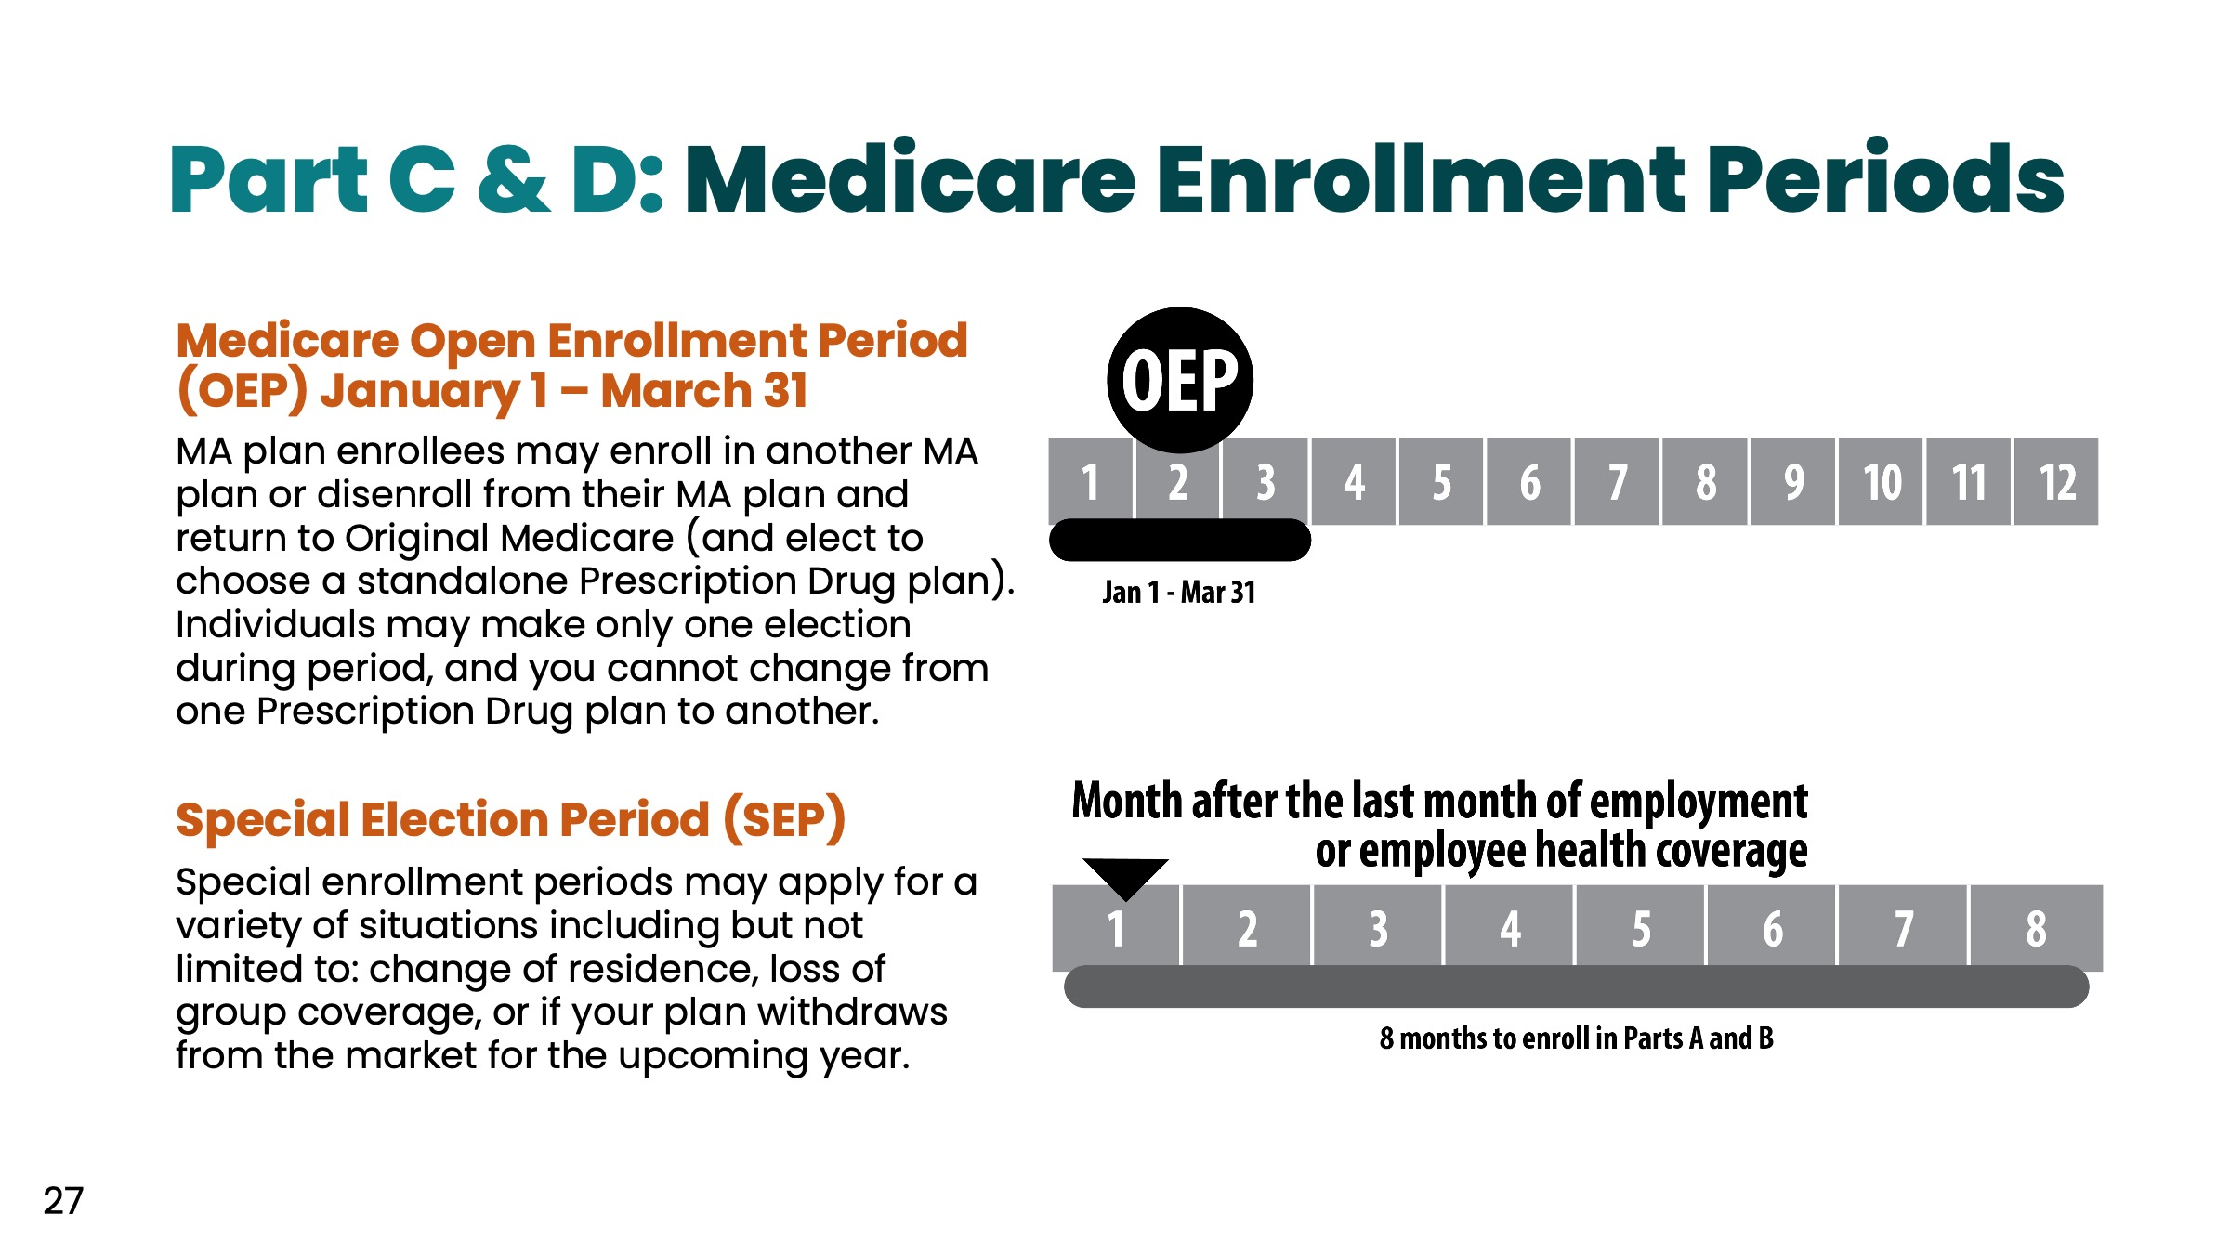
Notes:
Read sections

Slide 28
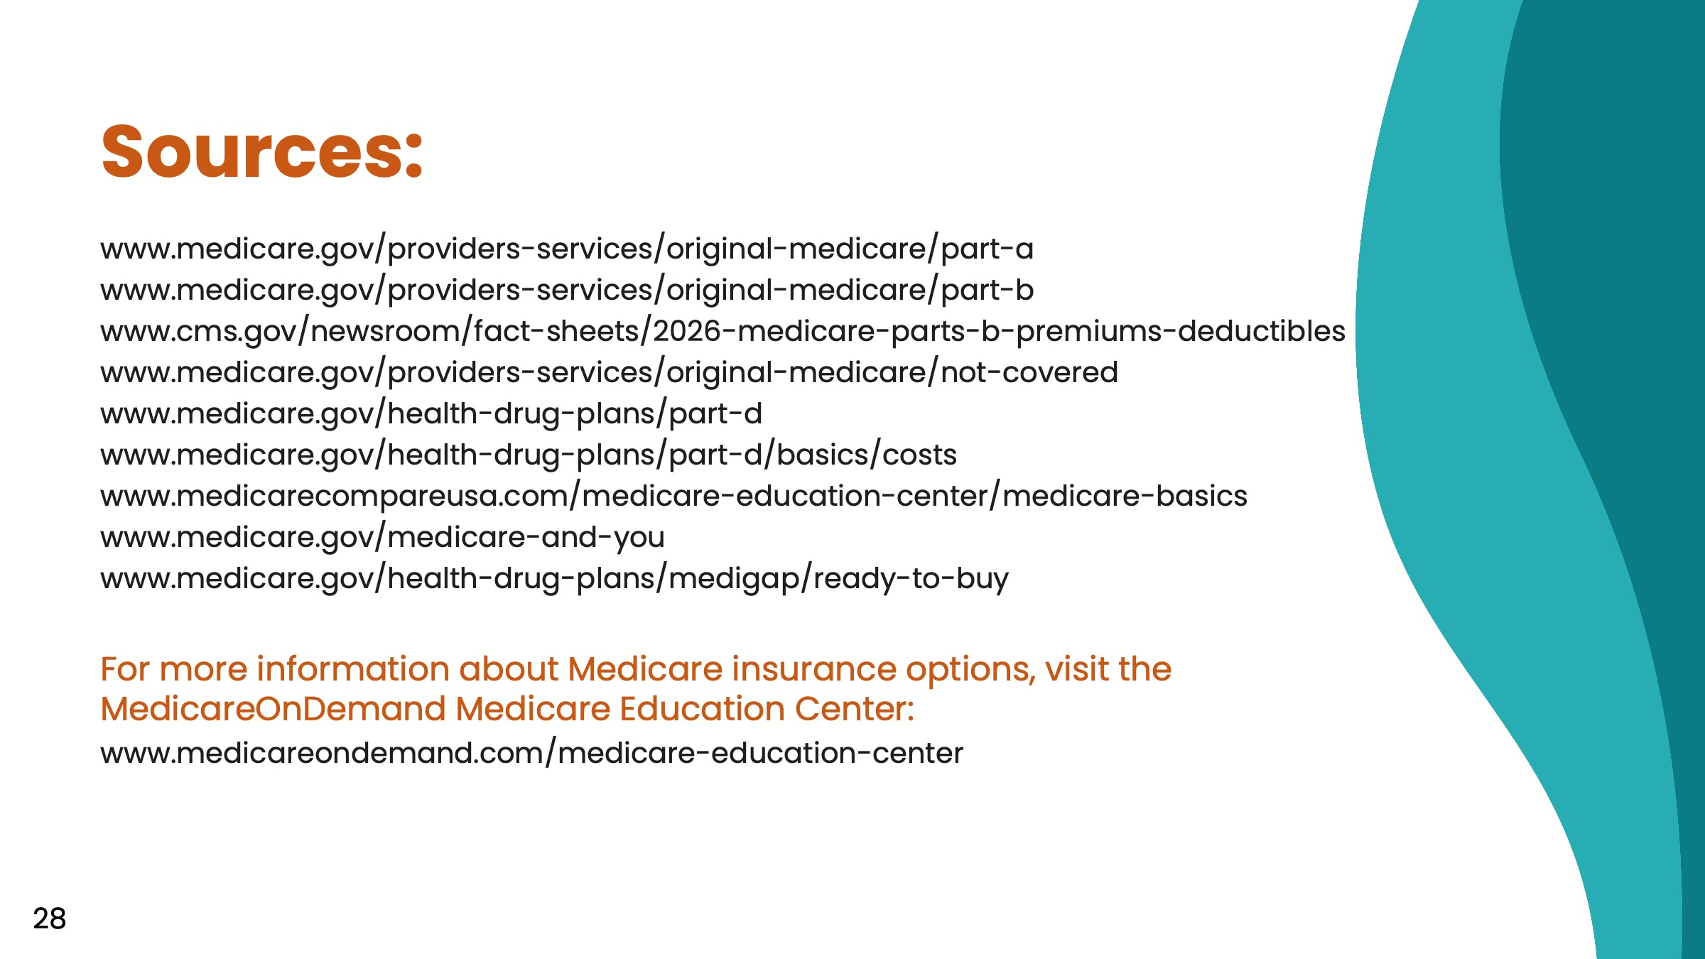

Slide 29


